Slide 1


ELECTRON STORE
CPIT 405
FATIMAH ALYAMI - SARAH ALMESHAAL - THURAYA ALFAHMI

Slide 2
CONTENT
Introduction
Database
Task Distribution
Conclusion

Slide 3

INTRODUCTION
Our project's idea is about an an online store that sells verity of electronics. The store provides three categories of electronics, audio visuals, moniotrs and laptops.
Languages Used:
HTML
CSS
JavaScrpit
PHP
Database:
MySQL

Slide 4

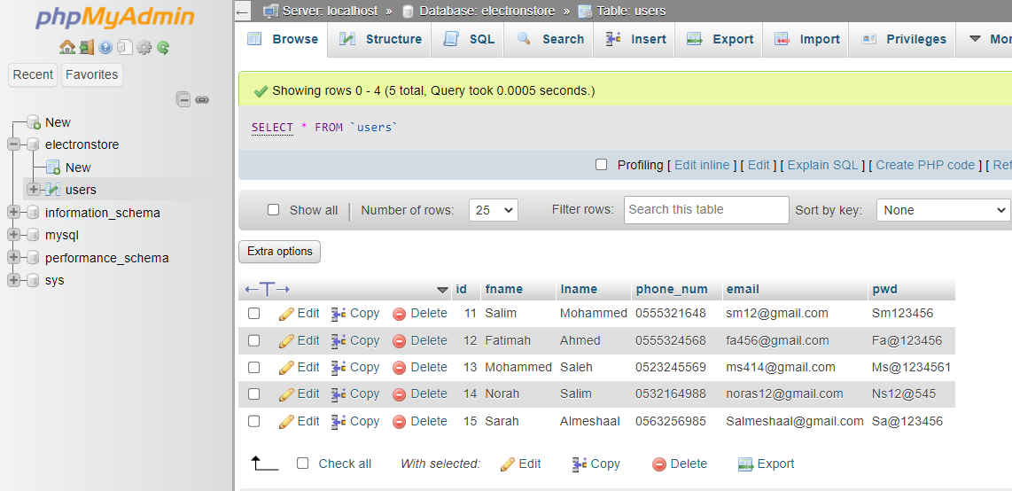

DATABASE
Table User

Slide 5
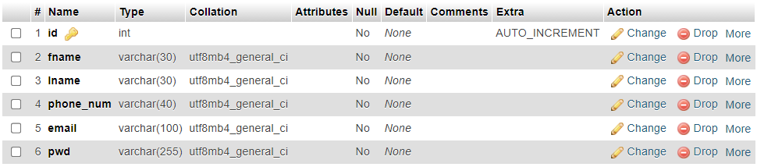
DATABASE
Structure of Table Users

Slide 6
TASK DISTRIBUTION

Slide 7
[ THURAYA]

Slide 8
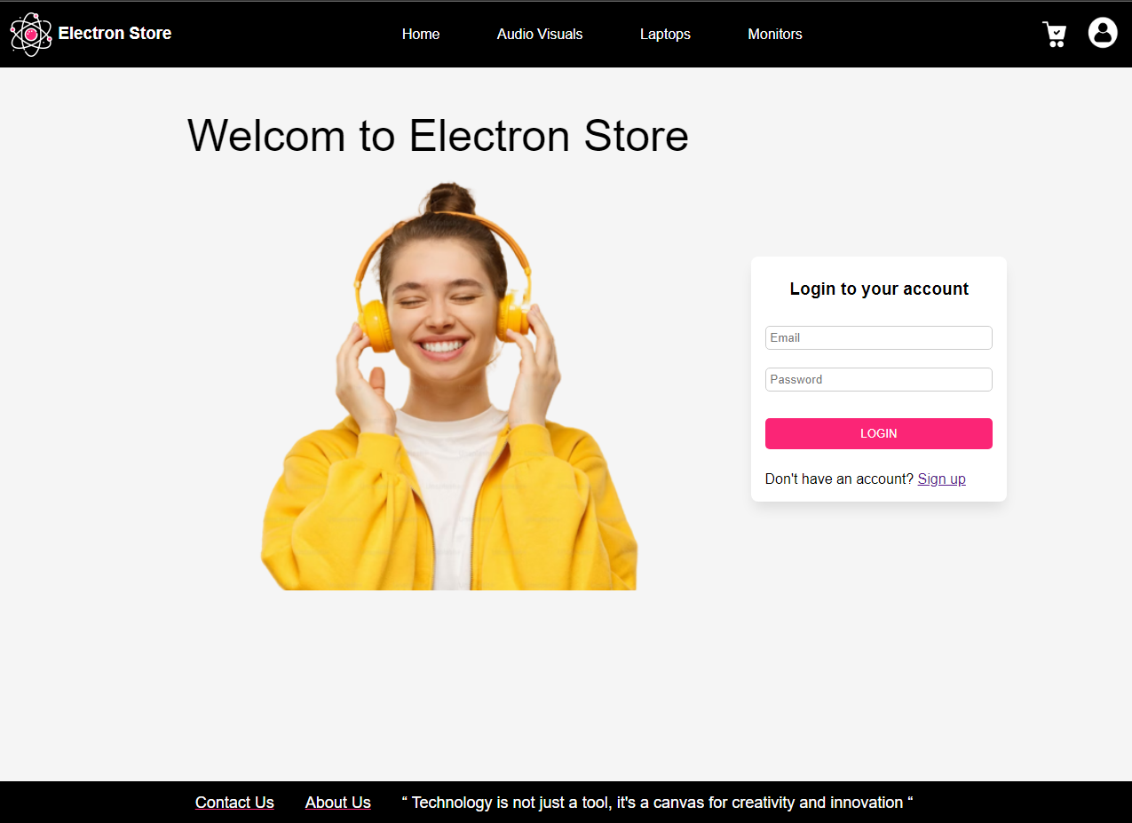
LOGIN

Slide 9
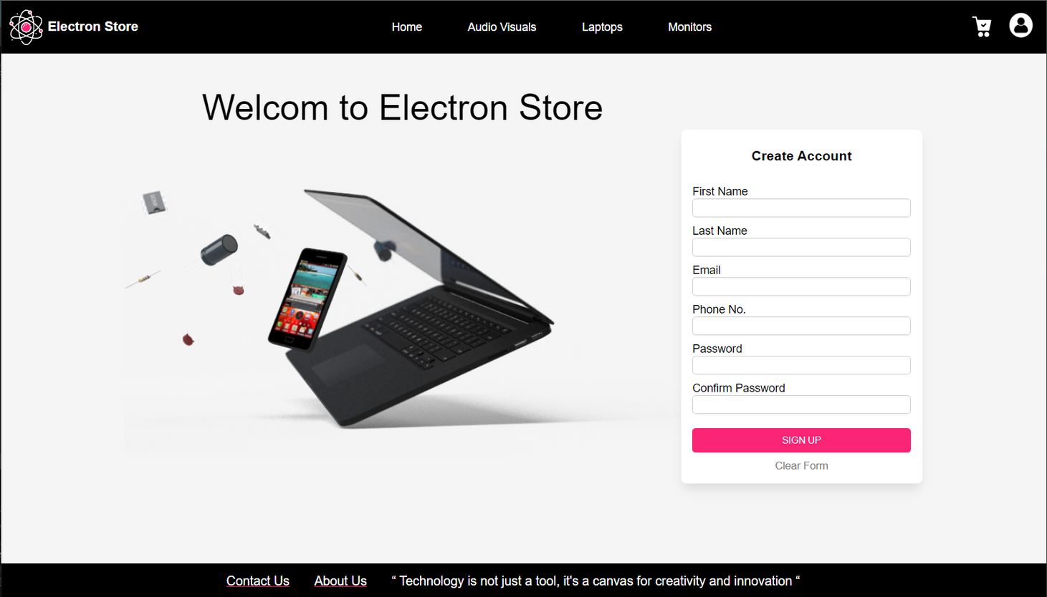
CREATE ACCOUNT

Slide 10
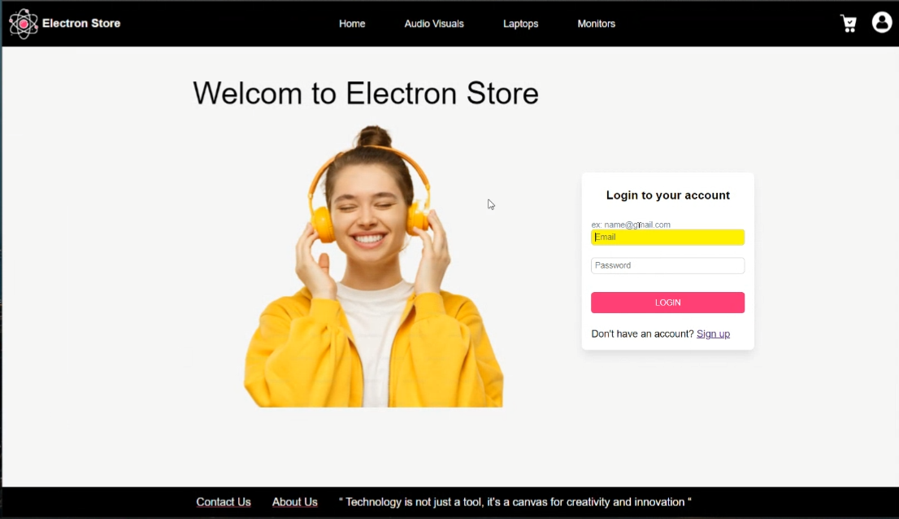
ONE KEY UP VS ONE KEY DOWN

Slide 11
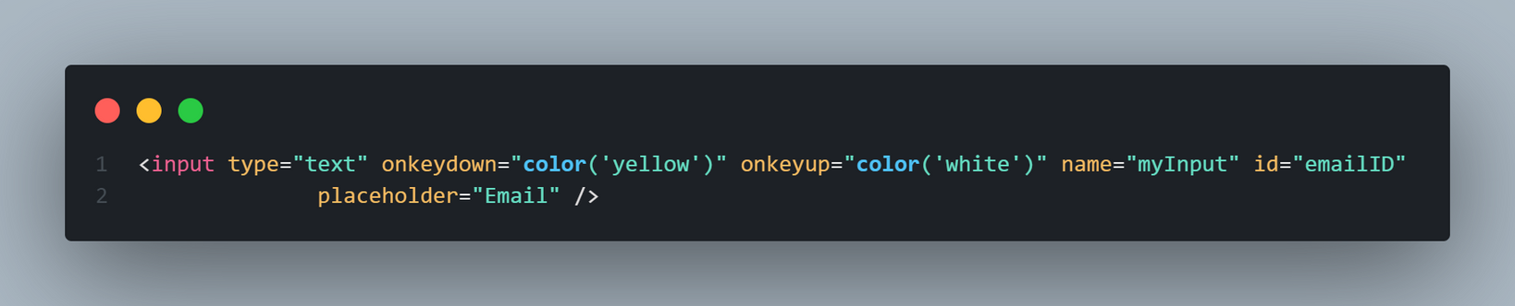
ONE KEY UP VS ONE KEY DOWN

Slide 12
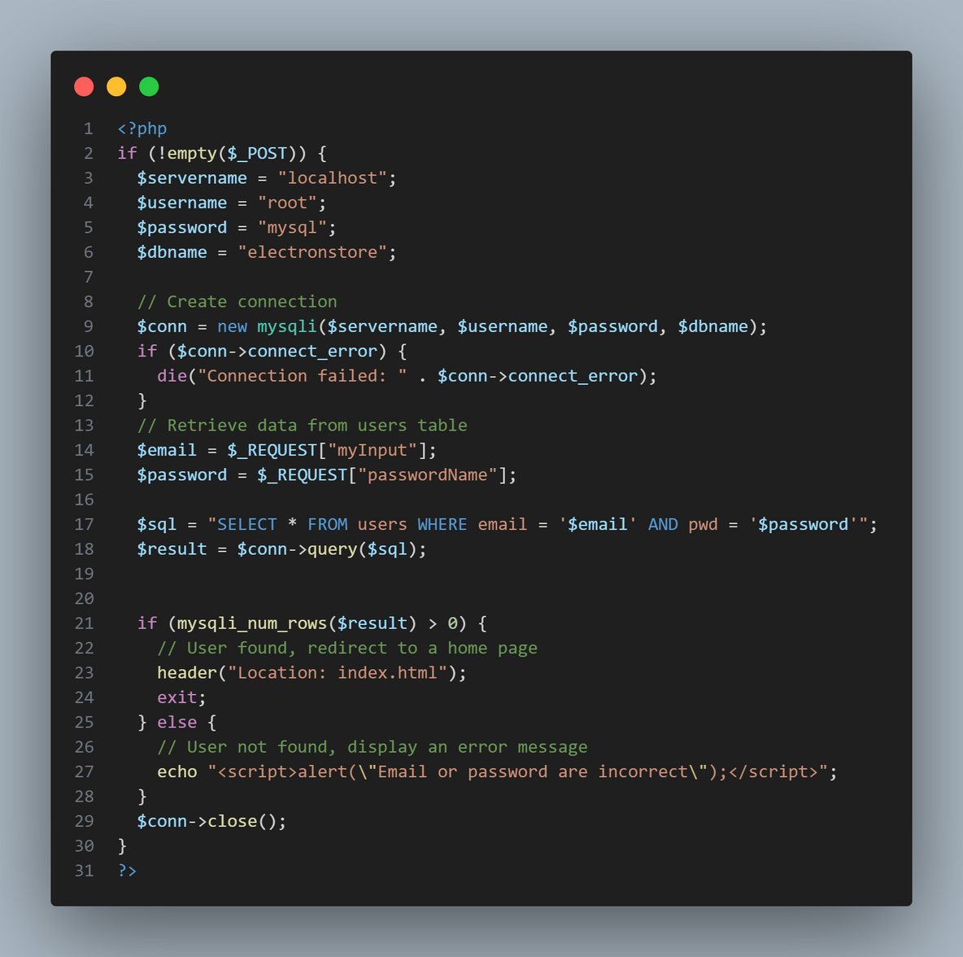
RETRIEVE DATA

Slide 13
[ SARAH]

Slide 14
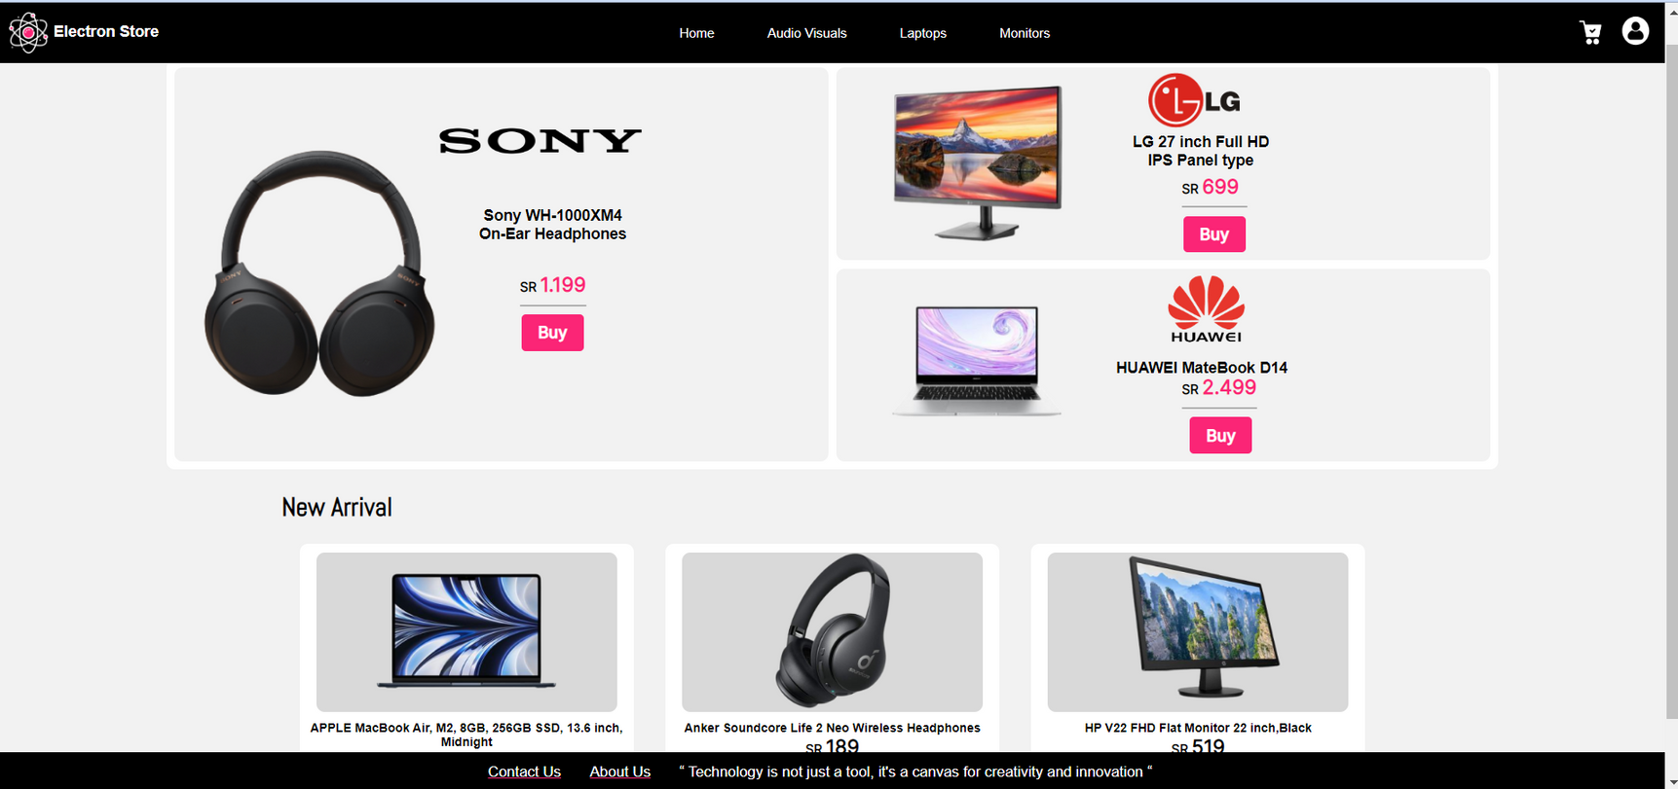
HOME PAGE

Slide 15
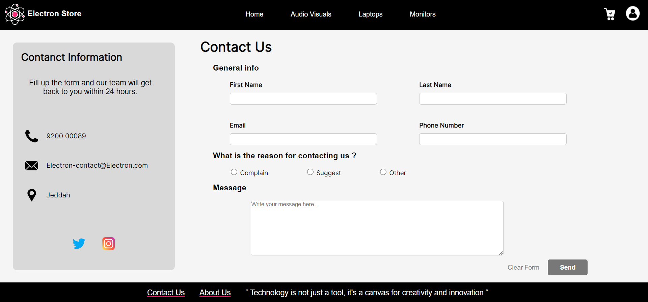
CONTACT US

Slide 16
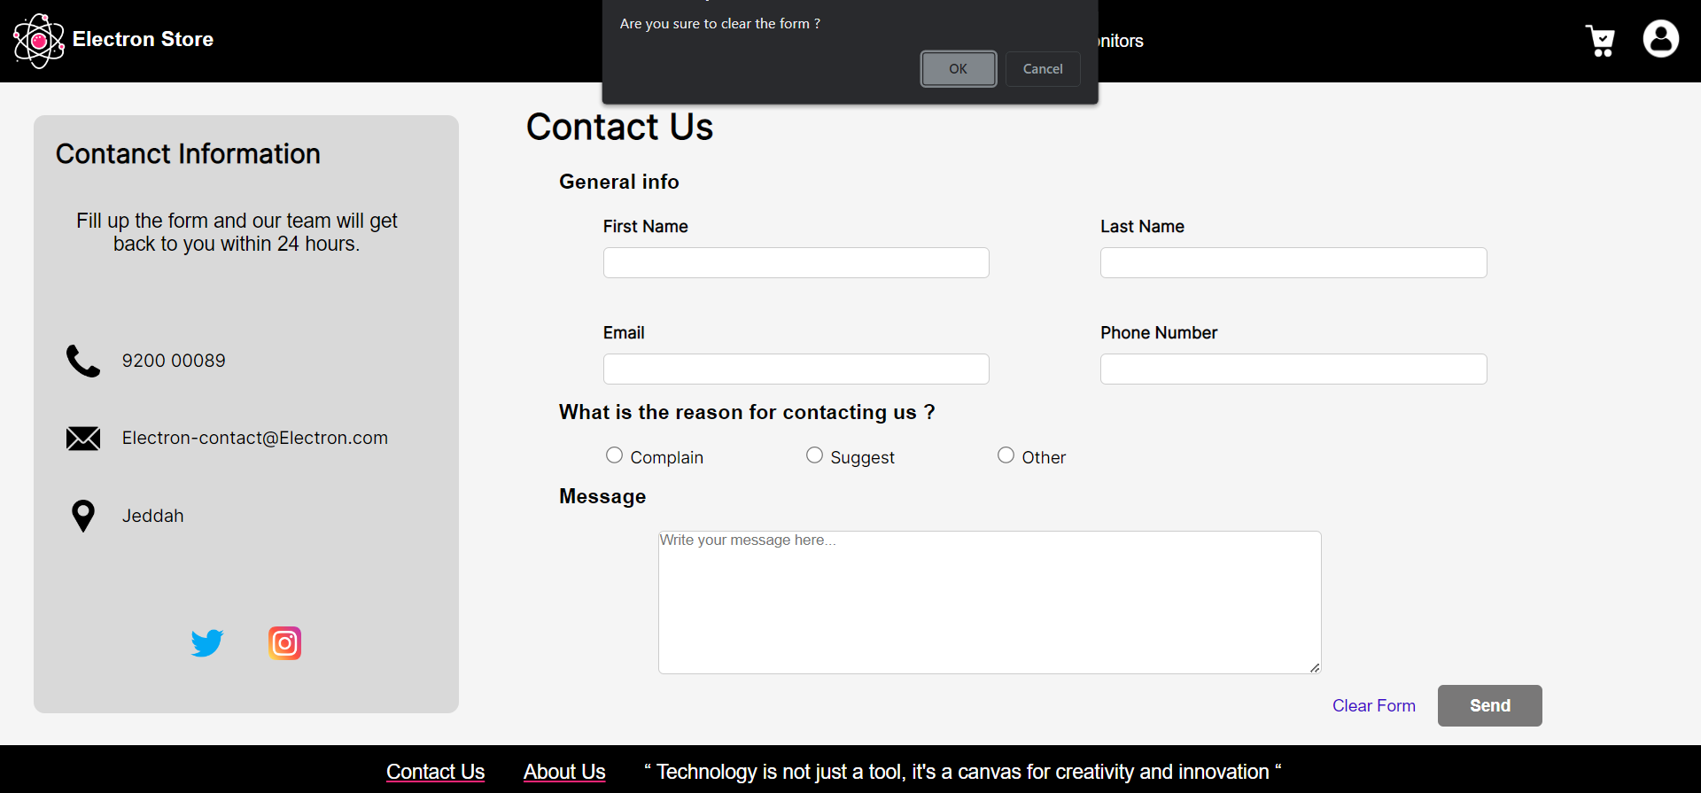
CONFIRMATION

Slide 17
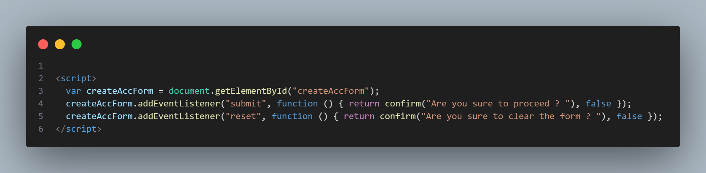
CONFIRMATION CODE

Slide 18
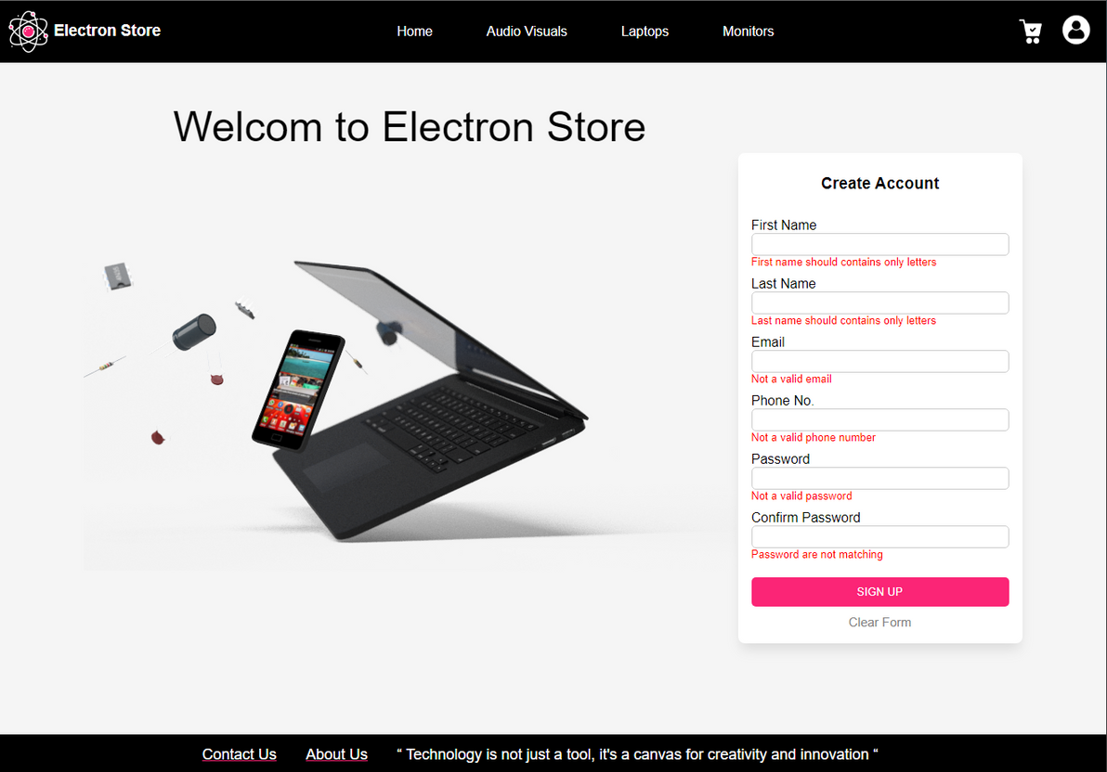
FIELDS VALIDATIONS

Slide 19
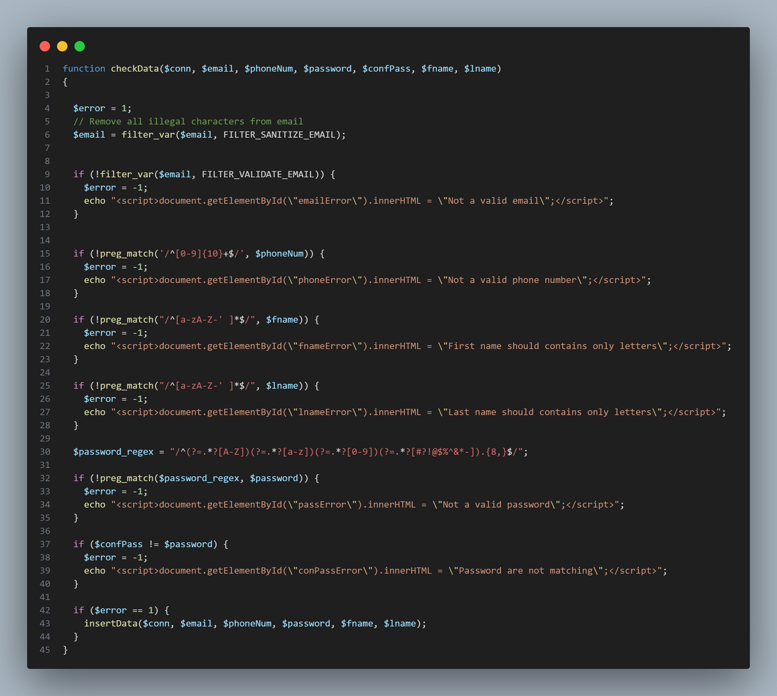
FIELDS VALIDATIONS CODE

Slide 20
[ FATIMAH ]

Slide 21
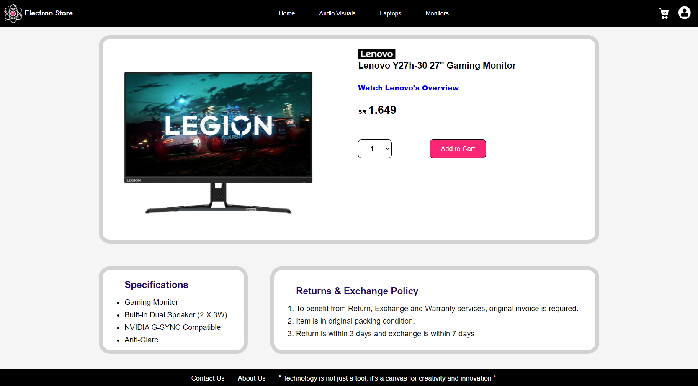
PRODUCT PAGE

Slide 22
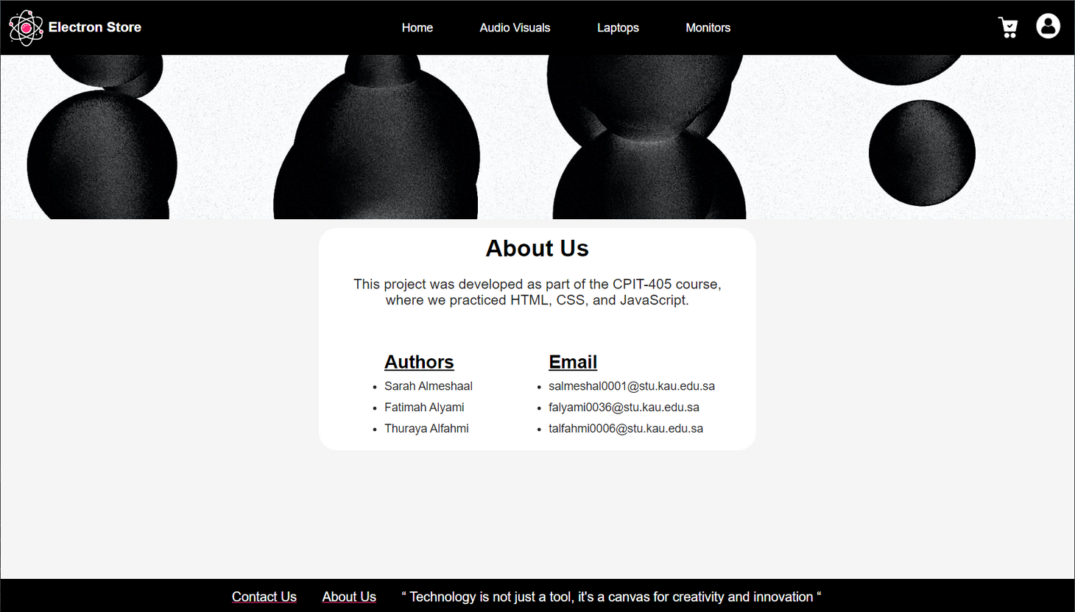
ABOUT US PAGE

Slide 23
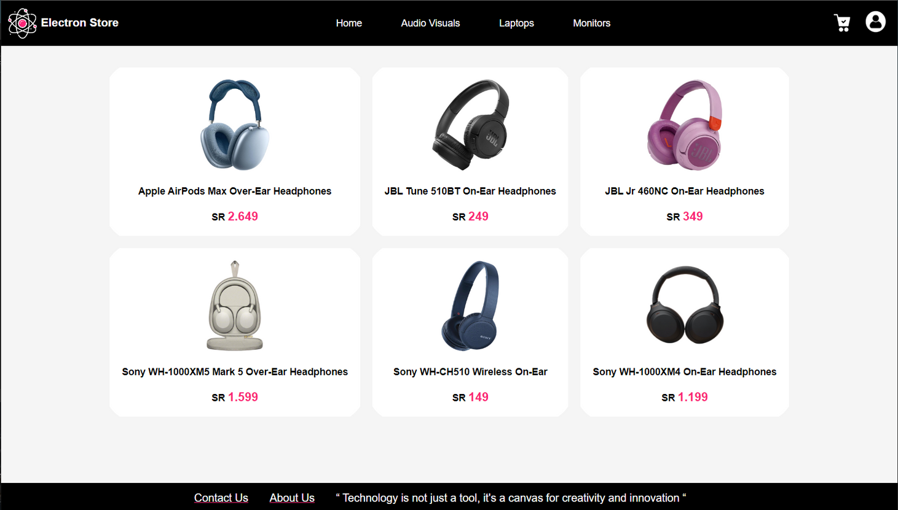
AUDIO VISIULAS

Slide 24
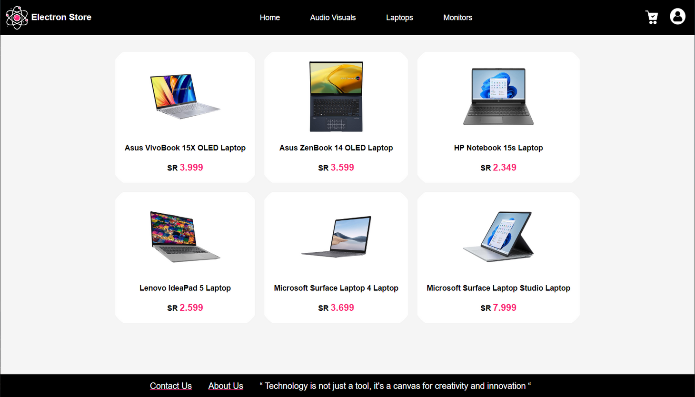
LAPTOPS

Slide 25
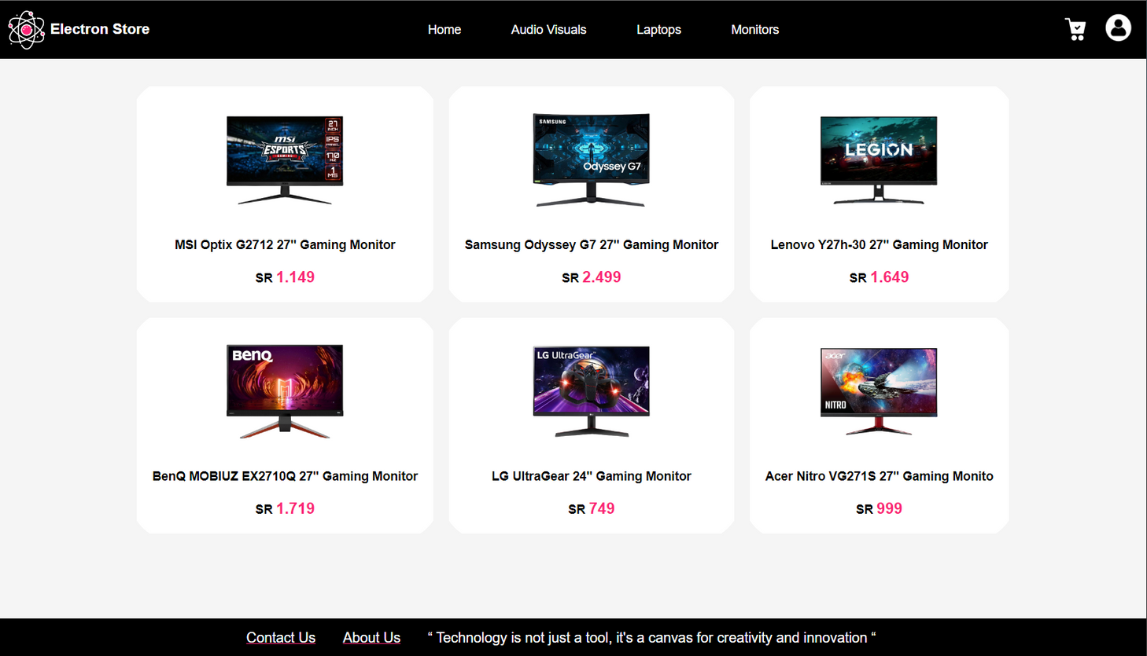
MONITORS

Slide 26
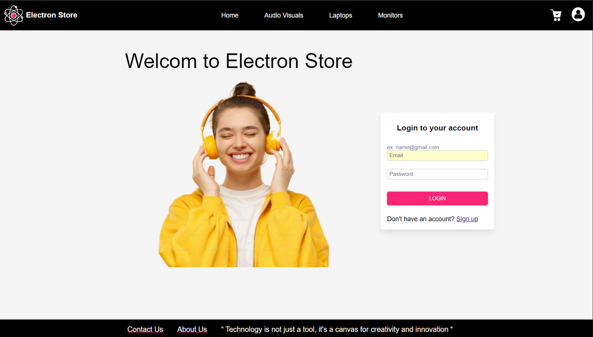
FOCUS & BLUR EVENTS

Slide 27
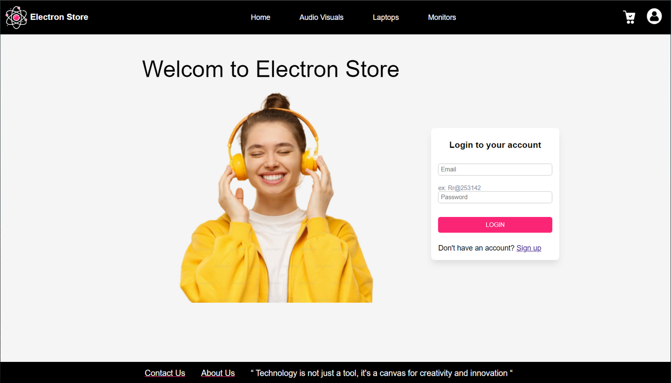
FOCUS & BLUR EVENTS

Slide 28
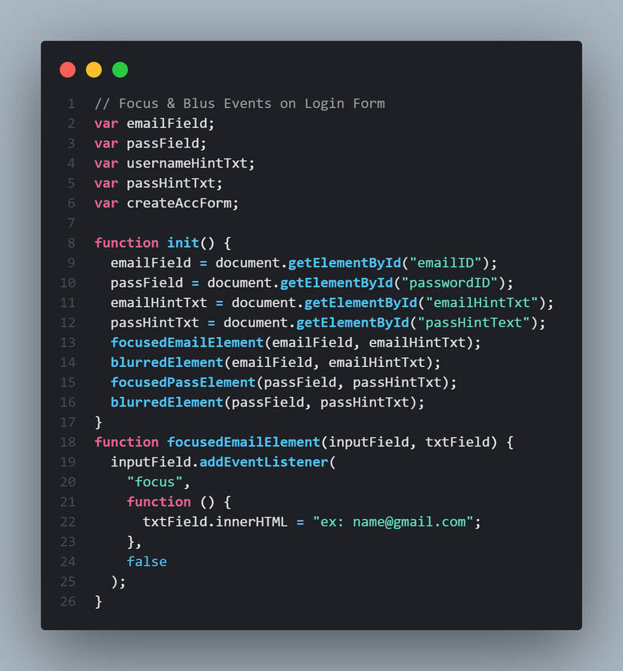
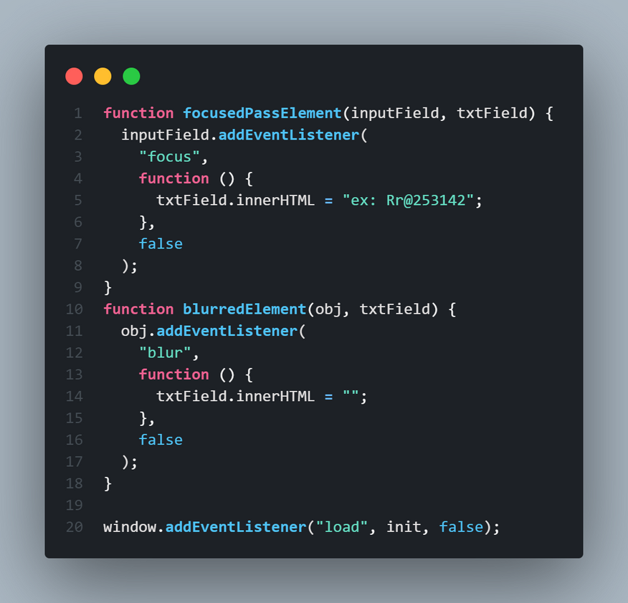
FOCUS & BLUR EVENTS

Slide 29
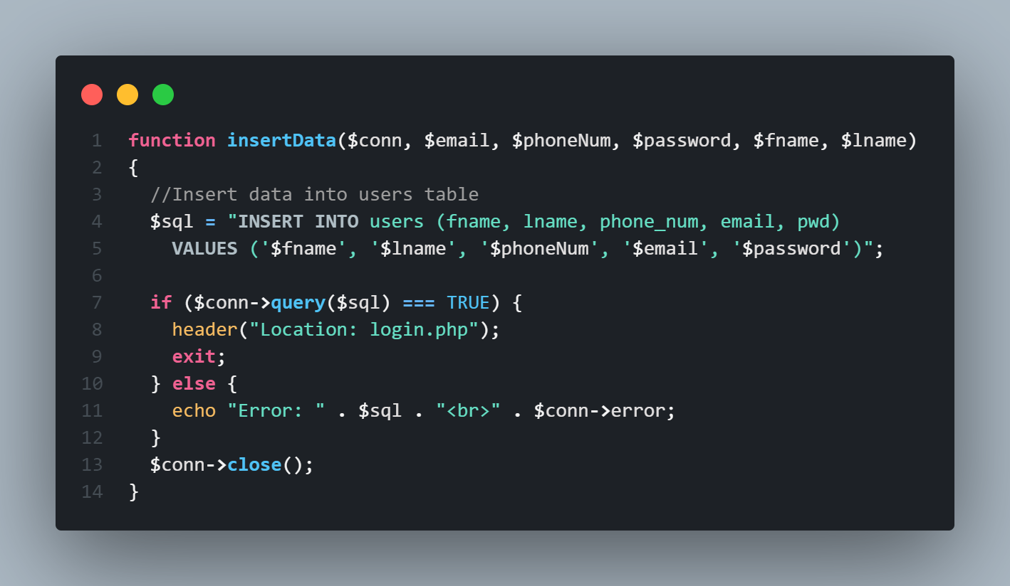
INSERT INTO DB

Slide 30
CONCLUSION
This project gave us the opportunity to discover and practice the basics of web development. We worked together as a team to implement Electron Store website using HTML, CSS, JavaScript, and PHP.

Slide 31
THANK YOU!
ANY QUESTIONS?

